Slide 1
Project Title: Sales Insights - Data Analysis using SQL and Tableau
Slide 1 - Project Title
Slide 2 – Profit Analysis Dashboard
Slide 3 – Revenue Analysis Dashboard
https://github.com/RishabhCodeLab
https://www.linkedin.com/in/rishabhg19/
By – Rishabh Goswami

Slide 2
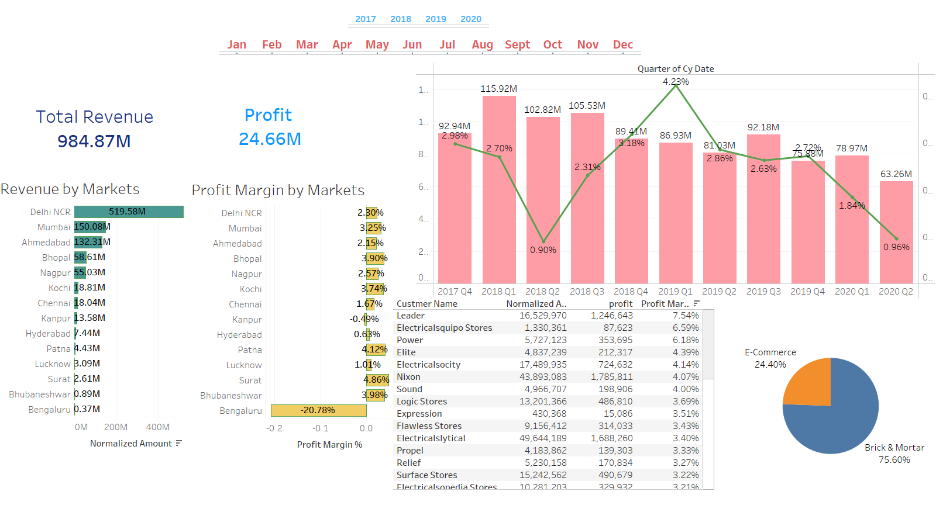

Slide 3
